Slide 1

Chemistry update Alvaro Magalhaes 7th March 2024
School of Pharmacy
Core D Meeting

Slide 2

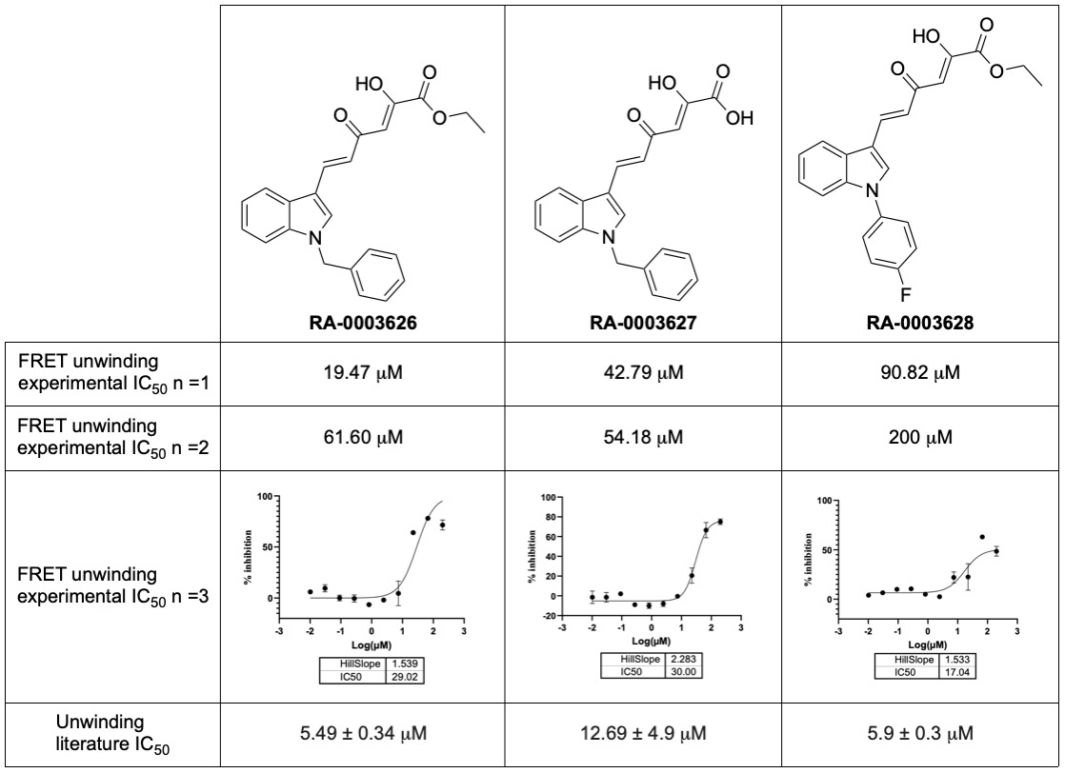
CNP8 – SARS-CoV-2 nsp13
Indole-based series of compounds from poster/literature
10.1016/j.antiviral.2023.105697
Literature show inhibition below 15 μM
Four molecules were selected for synthesis:
Three completed and shipped for assessment;
One kept impure in our lab.
Mixed results
Paper used SSYA100-01 and Licoflavone C has controls for biochemical assays
GitHub: CNP8-Nsp13-Indoles

Slide 3
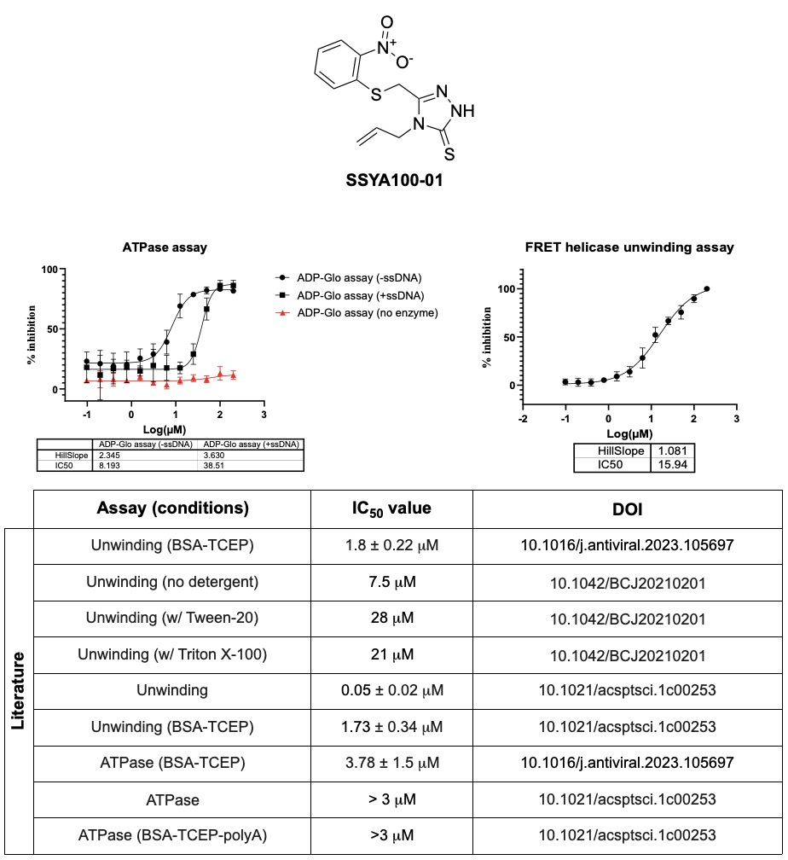
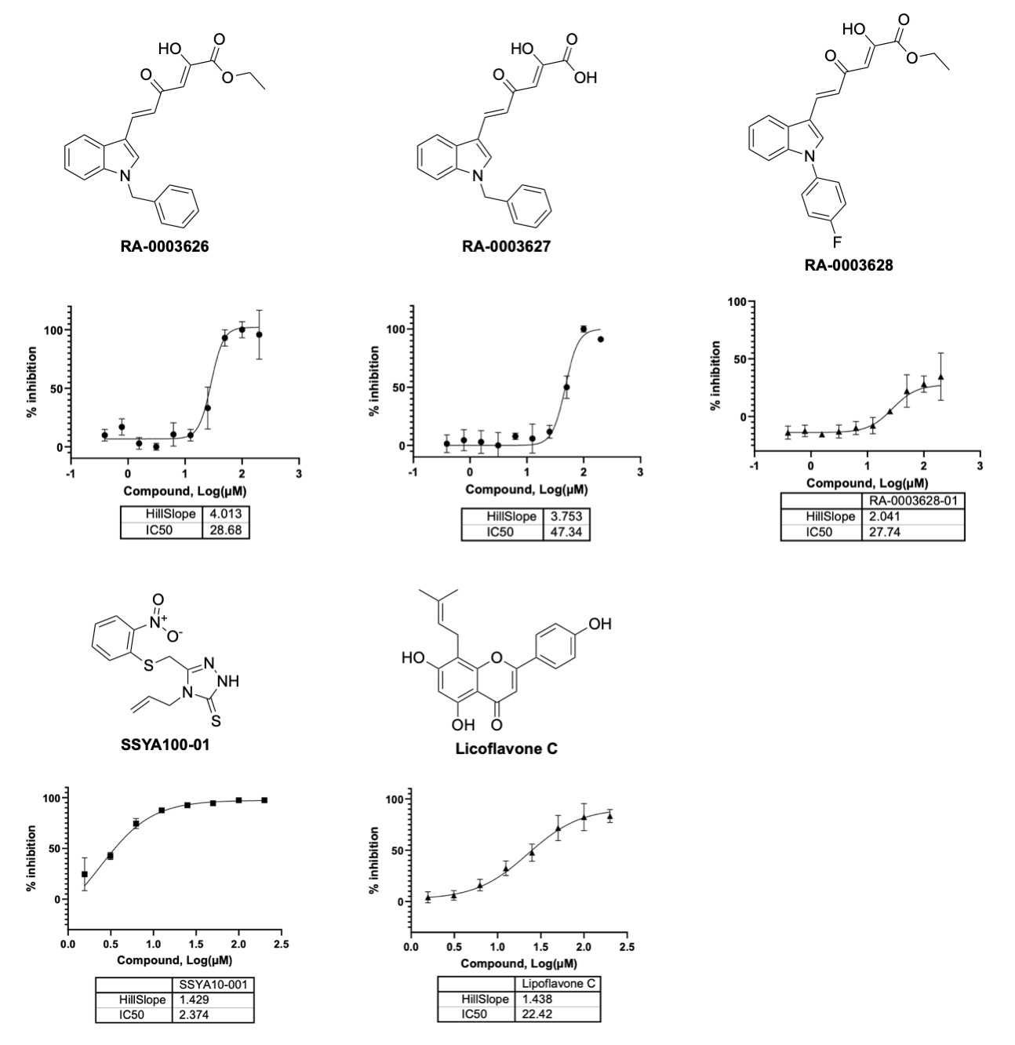
CNP8 – SARS-CoV-2 nsp13
FRET Unwinding (Ivanna)
Licoflavone C from lit: 7.8 ± 1.2 μM
GitHub: CNP8-Nsp13-Indoles

Slide 4
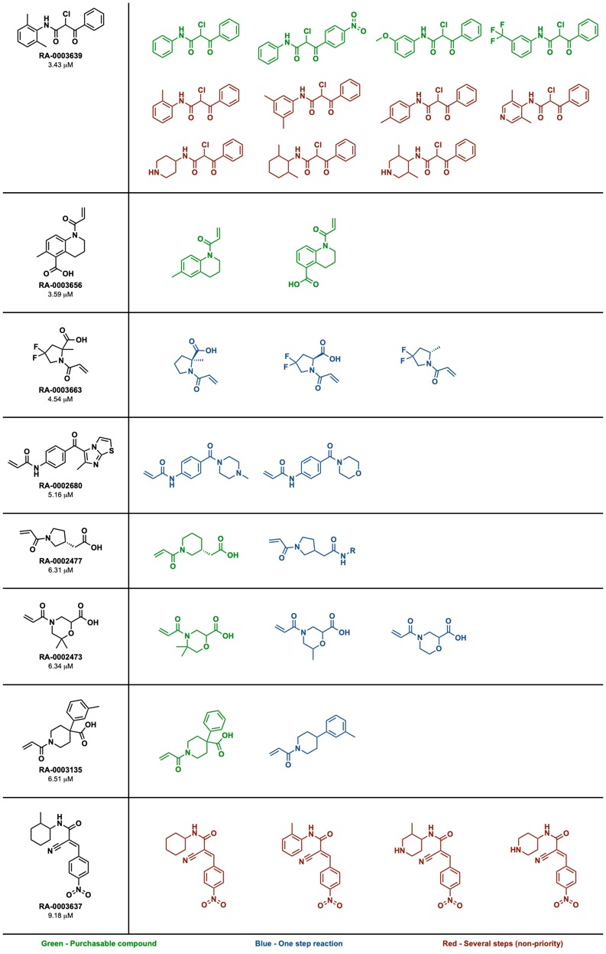
CNP19 – CHIKV nsp2 Enamine Covalent
6K covalent compounds tested vs CHIKV nsp2 helicase
64 compounds were repurchased (≥ 46 % inhib @ 20 μM)
17 compounds showed IC₅₀ below 10 μM
8 compounds passed PAINS and promiscuity → selected
Antiviral data only available for three and doesn’t show inhibition
Expansion done by simplification
Next round will be towards increasing MW
9 compounds shipped; another 9 compounds being synthesised
Deprioritised → long synthesis
CNP19-CHIKVhelicase-Covalent

Slide 5

CHIKV nsp2 Asinex Diversity Set
50K compounds vs CHIKV nsp2 (HTS still ongoing – 50 plates left)
186 compounds showed inhibition below 36 % @ 25 μM (100 plates)
16 have been shipped for testing (selected at UCL)
16 compounds already tested (selected by UNC):
One is a PAINS;
Other has extensive SAR on the HTS.

Slide 6
CHIKV nsp2 Asinex Diversity Set
CHIKV
VEEV
Cytotoxicity
RA-0009735 has been flagged as PAINS
Methylating the hydroxyl removes the flag
Should we try to make it?

Slide 7
CHIKV nsp2 Asinex Diversity Set
CHIKV
VEEV
Cytotoxicity

Slide 8
RA-0002034 NMR experiment
Using maleic acid as internal standard, we performed the NMR experiment to observe loss of RA-0002034 by NMR
Final [2024] was 9 mM
Stock solution 2034 (DMSO-d₆), stock solution of maleic acid (in D₂O), P_{i} buffer (0.2 M, pH 7) and more D₂O were combined. Mixture was centrifuged and supernatant analysed by NMR. Solid was dried in overnight, and it will be analysed
We observe a loss of about 22 % over 24 h (solid to be analysed too).
t = 0 h
t = 24 h

Slide 9
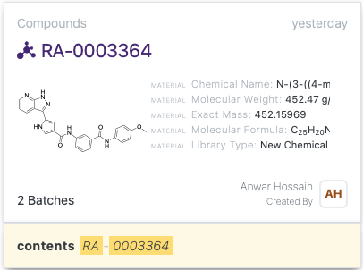
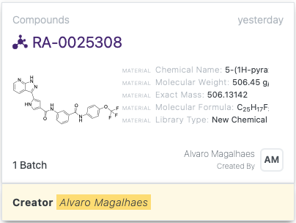
Takeda Hits → RA-0003364
Ready!

